Slide 1

T20 World Cup Data Analysis:
Building the Best XI

Slide 2

Hello!
In this project, I analyzed player statistics from the T20 World Cup using Python and Power BI. I started by loading and transforming data in Pandas, then created a six-page dashboard in Power BI. Each page focuses on different player categories: openers, middle order, lower order, all-rounders, and fast bowlers. Using advanced DAX queries, I generated KPIs and charts to calculate key cricket metrics like economy and strike rate. This analysis helps in selecting the best players for the final eleven based on performance stats, providing a professional and detailed report for building the best playing XI from the tournament.

Slide 3
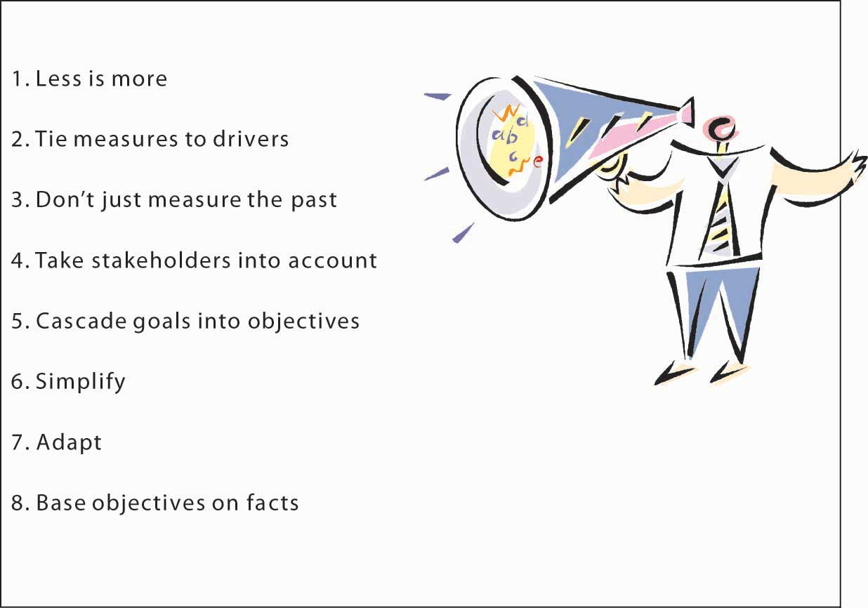
Objective:
Evaluate Player Performance: Analyze T20 World Cup player statistics to assess individual performance metrics.
Categorize Players: Provide detailed insights for different player categories, including openers, middle order, lower order, all-rounders, and fast bowlers.
Support Team Selection: Facilitate the selection of the optimal playing eleven based on performance data and team requirements.
Visualize Key Metrics: Use advanced DAX queries and visualizations to present important cricket metrics such as economy rate and strike rate.
Enhance Decision-Making: Enable data-driven decision-making by offering a professional and interactive dashboard for team analysis.

Slide 4

Outcomes
Detailed Player Insights: The dashboard offers comprehensive metrics on player performance across categories such as openers, middle order, and bowlers, aiding in precise team selection.
Advanced Metrics Visualization: Key cricket metrics like economy rate and strike rate are visualized using advanced DAX queries, providing clear insights into player effectiveness.
Optimized Team Selection: The final page allows users to select the best playing eleven based on thorough statistical analysis, ensuring a data-driven approach to team building.
Interactive and User-Friendly: Filters and tooltips enhance the dashboard's usability, enabling detailed exploration of player stats and performance trends.
Professional Dashboard Design: The dashboard is crafted with a professional layout, presenting complex data in an accessible and engaging manner.

Slide 5
Power Bi Reports:

Slide 6
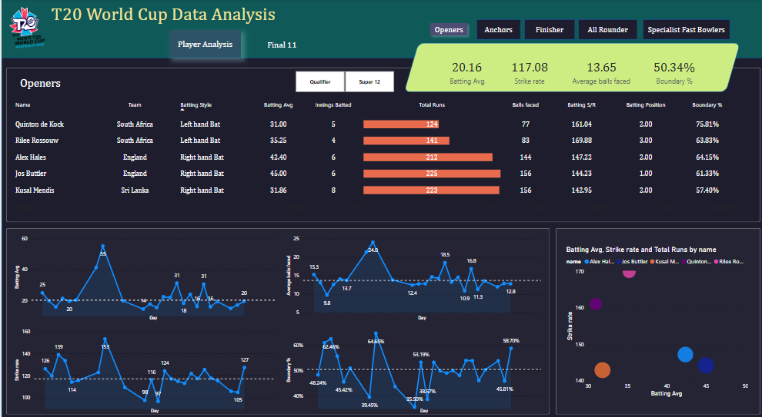

Slide 7
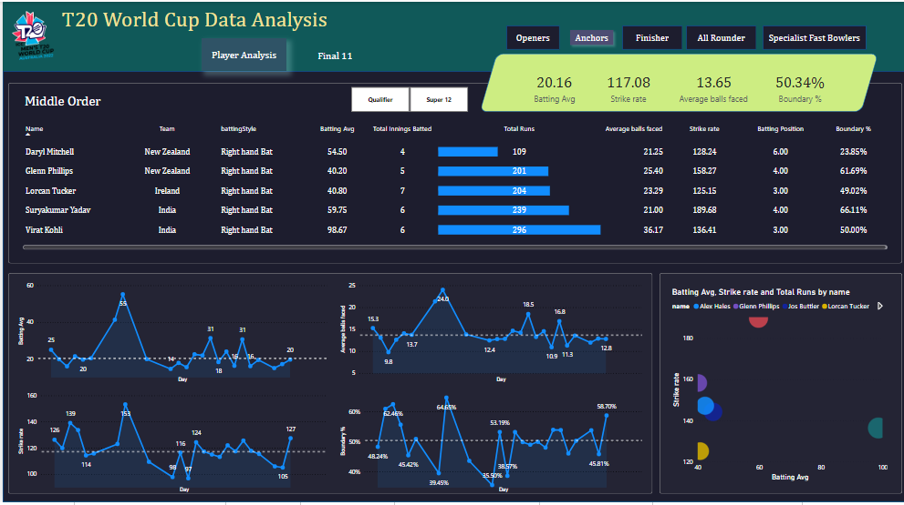

Slide 8
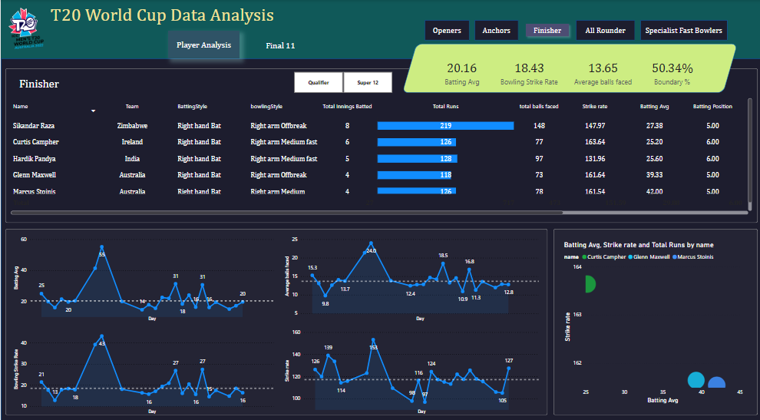

Slide 9
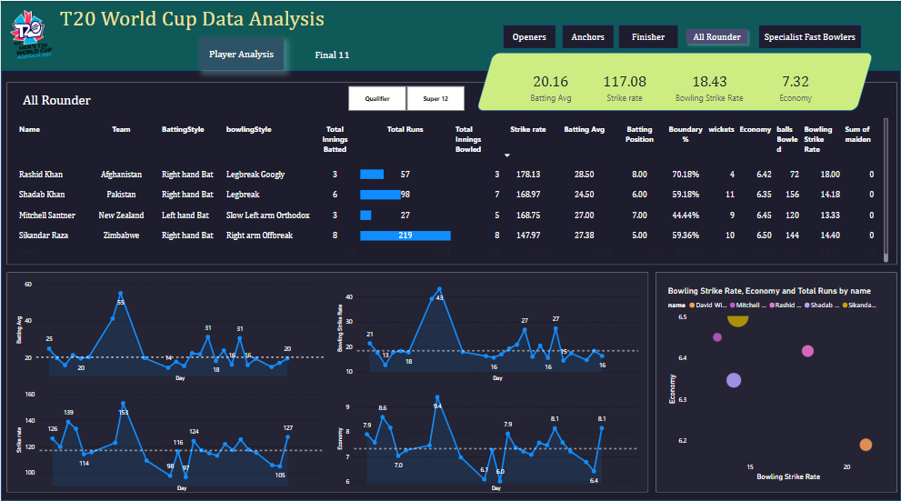

Slide 10
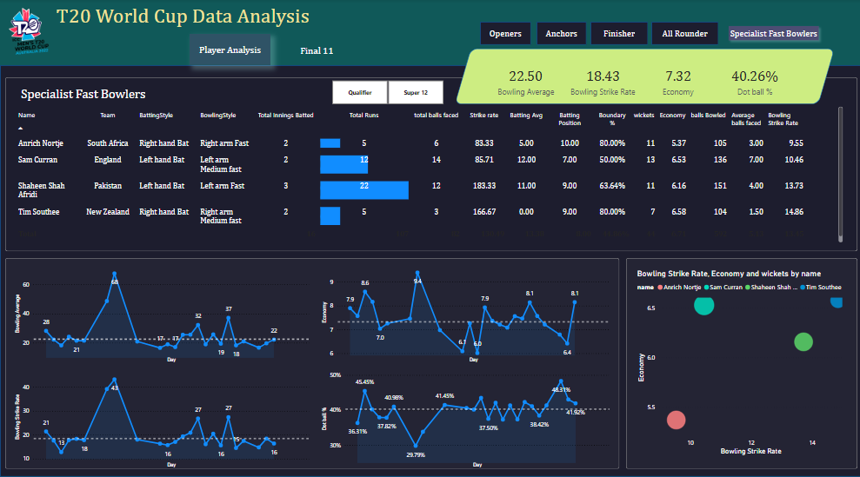

Slide 11
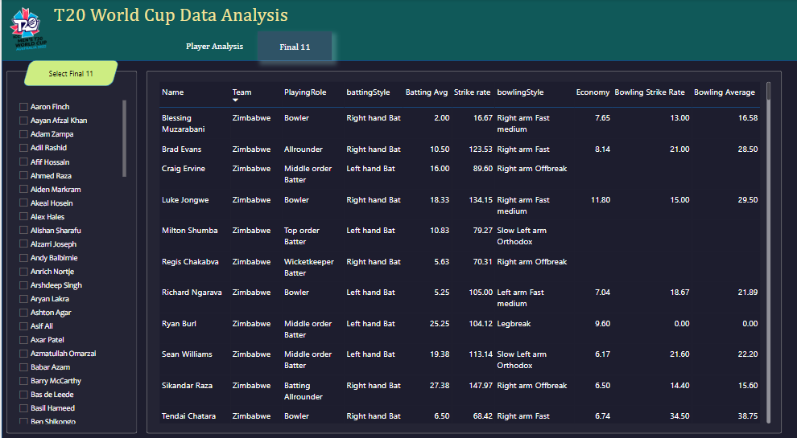

Slide 12
Methodology and overview:
This exploratory project aimed to analyze T20 World Cup player statistics to aid in team selection. The methodology involved collecting detailed performance data from the tournament and preprocessing it using Pandas to clean and enhance the dataset. Transformed data was then imported into Power BI, where a six-page interactive dashboard was developed. This dashboard utilized advanced DAX queries to calculate key performance metrics and included interactive features such as filters and tooltips to facilitate comprehensive data exploration and visualization.

Slide 13
Thank you
As we wrap up this chapter of our journey, I want to express my gratitude for your time and attention. Thank you for taking the time to review this project on T20 World Cup player analysis. I appreciate your interest in exploring how data can enhance team selection and performance evaluation. I hope this presentation provides valuable insights into player statistics and demonstrates the capabilities of interactive data visualization. If you have any questions or require further information, please feel free to reach out. Thank you once again for your attention and support.

